Slide 1
Threading Wrapup
CS221 – 4/29/09

Slide 2


Slide 3
Concurrent Collections
Java supplies a set of concurrent collections you can use manage sets of data in a multi-threaded program
Examples
ArrayBlockingQueue
ConcurrentHashMap
ConcurrentNavigableMap

Slide 4
ArrayBlockingQueue
Queue data structure with some added benefits
Blocks when you attempt to add to a full queue
Blocks when you attempt to remove from an empty queue
Wakes up the blocked thread when the queue is ready once more
Safe to use with as many threads as you wish

Slide 5
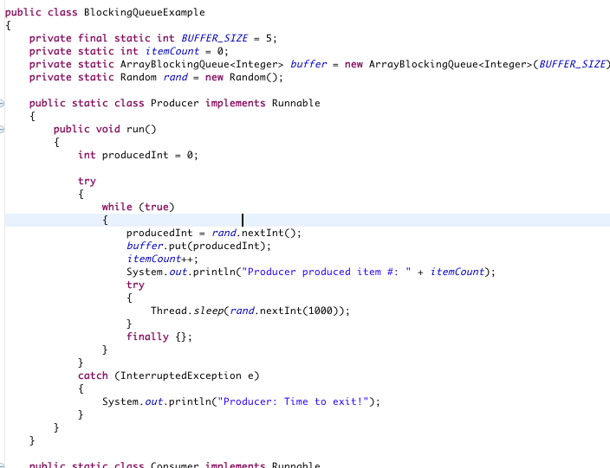
Example
Let’s convert producer-consumer to use this datastructure!

Slide 6
MultiThreaded Dots
Let’s convert our dot moving program to use multiple threads.
Steps
Decide what should be in each thread
Move MouseMotionListener to new thread
Move mouse event handlers to the new thread
Start the new thread from MoveComponent constructor

Slide 7
MultiThreaded Dots
To be safe: Convert Dots class to use Vector instead of ArrayList
Tip: Vector is thread-safe and ArrayList is not
Note: If we’d designed Dots class better we could have replaced ArrayList with Vector without having to modify the calling code.
What would have been a better way to design this class?

Slide 8
Semaphore
Semaphore is a generalized version of a mutex.
A mutex is mutually exclusive, only one thread can access at a time.
A semaphore can allow 1..n threads access at a time.
If you reduce semaphore to 1 thread, it is a mutex.
http://java.sun.com/javase/6/docs/api/java/util/concurrent/Semaphore.html

Slide 9
Thread Priorities
You can use thread priority to give some of your threads higher priority than others.
Higher priority threads will get more CPU cycles than lower priority threads

Slide 10
Example
Create an applet with two counting threads
See how the thread priority changes counting speed

